Slide 1

Analysis of Zomato Records

Slide 2
Contents:
Summary
Research Objective
Entity Relationship Diagram
Representing each of the research objectives
Dashboard
Recommendations

Slide 3
Summary
Zomato analysis is one of the most useful analysis for foodies who want to taste the best cuisines of every part of the world which lies in their budget.
This analysis is also for those who want to find the value for money in restaurants in various parts of the country for the cuisines.
Additionally, this analysis caters the needs of people who are striving to get the best cuisine of the country and which locality of that country serves that cuisines with maximum number of restaurants.

Slide 4
Research Objective
The data being used is the Zomato restaurants data in order to obtain the following objectives :-
Segregating the restaurants based on the ratings provided by the customers.
Higher is the rating, higher is the profit earned by the restaurant.
Finding the restaurants, which one’s provide online delivery and the one’s that don’t.
Segregating the restaurants based on the type of cuisines provided.
Simplifying the process of selecting the restaurants based on the no of votes.

Slide 5
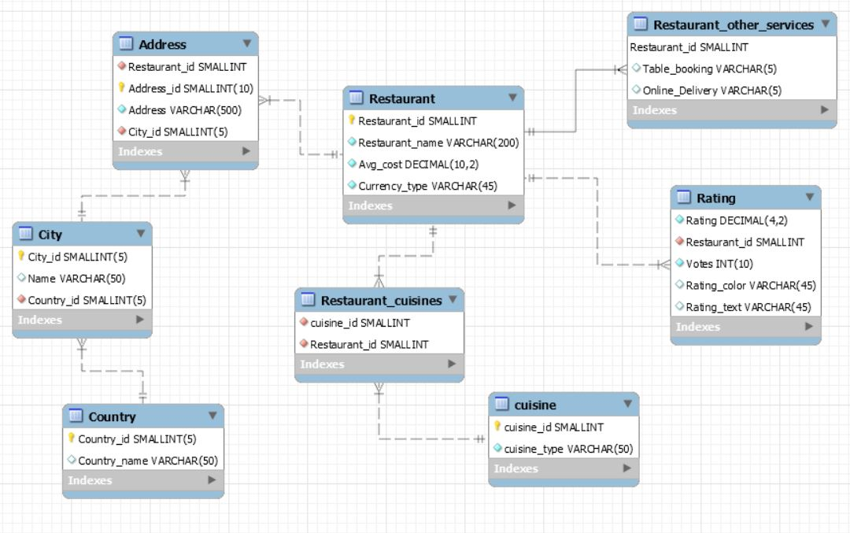
Entity Relationship Diagram

Slide 6
SQL Operations

Slide 7
Representing each of the research objectives (SQL Queries)

Slide 8
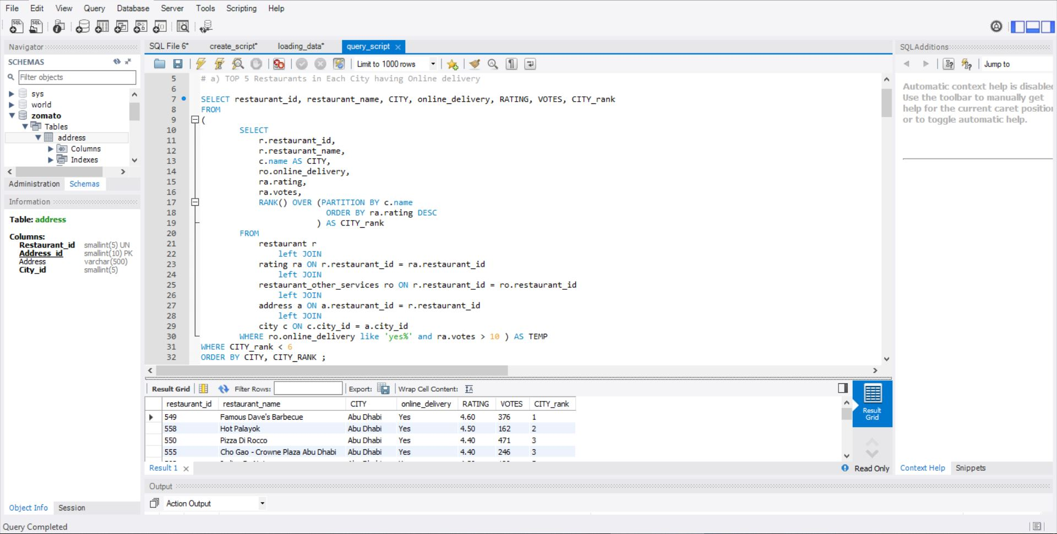

Slide 9
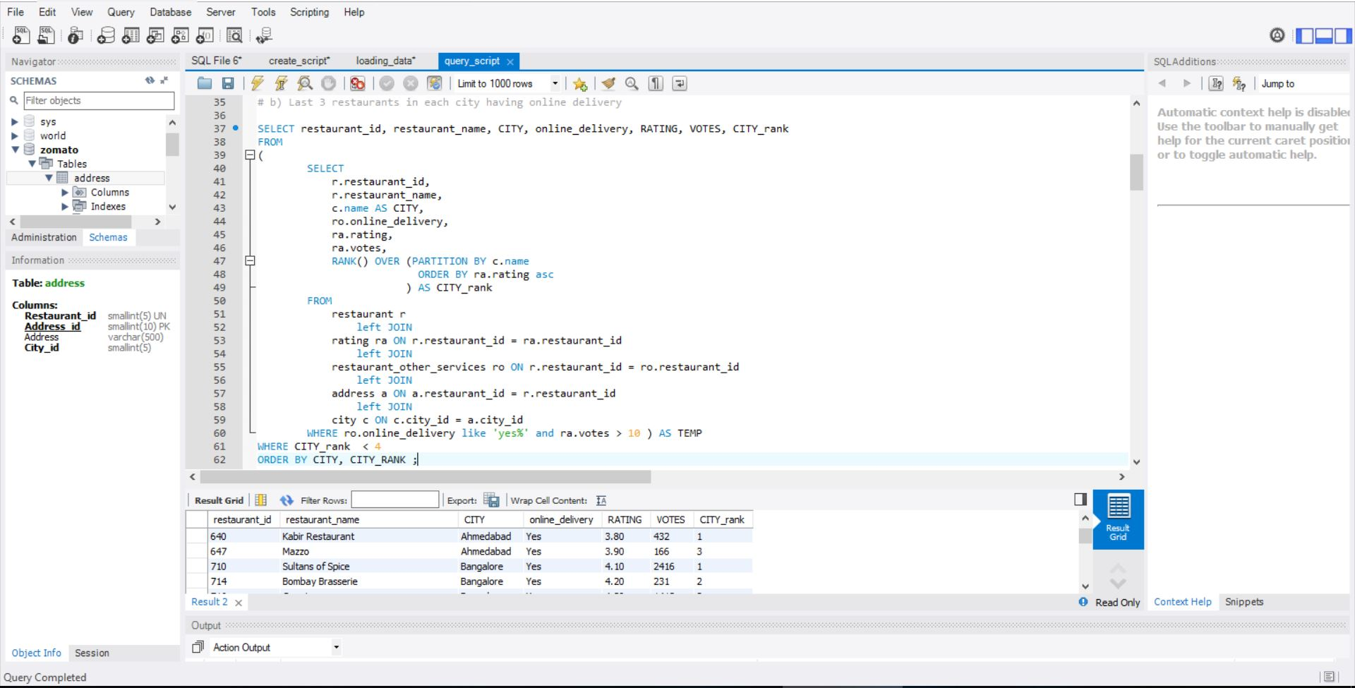

Slide 10
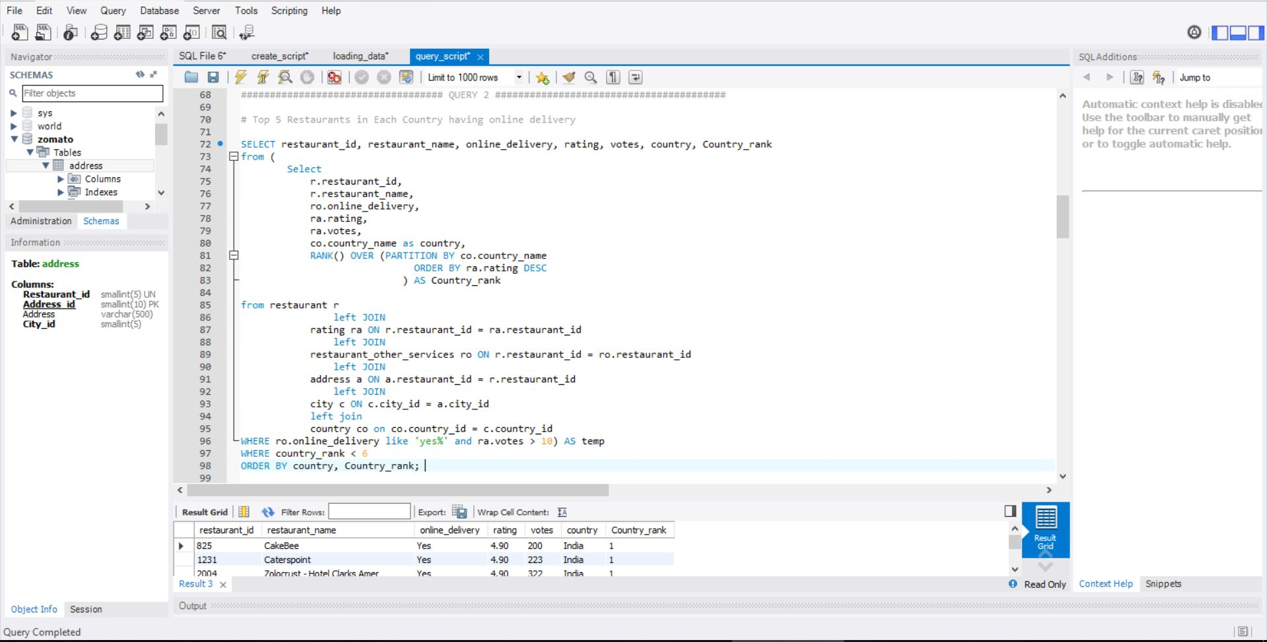

Slide 11
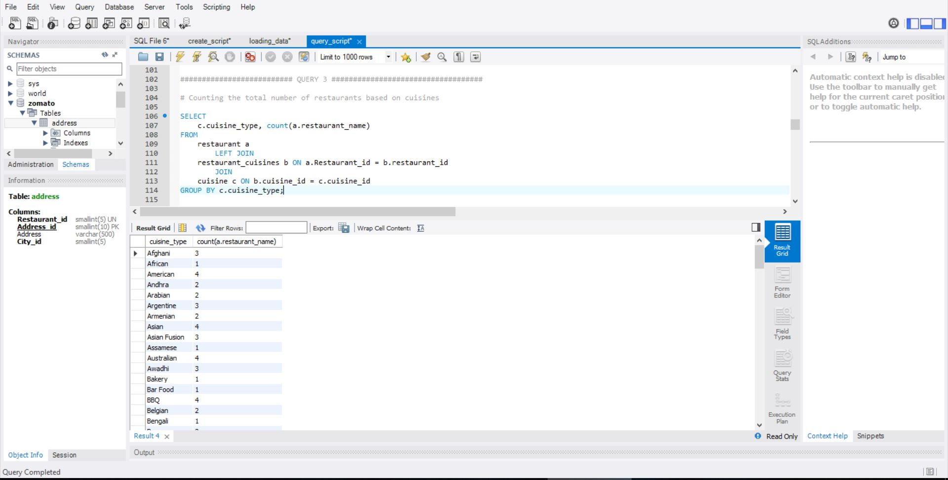

Slide 12
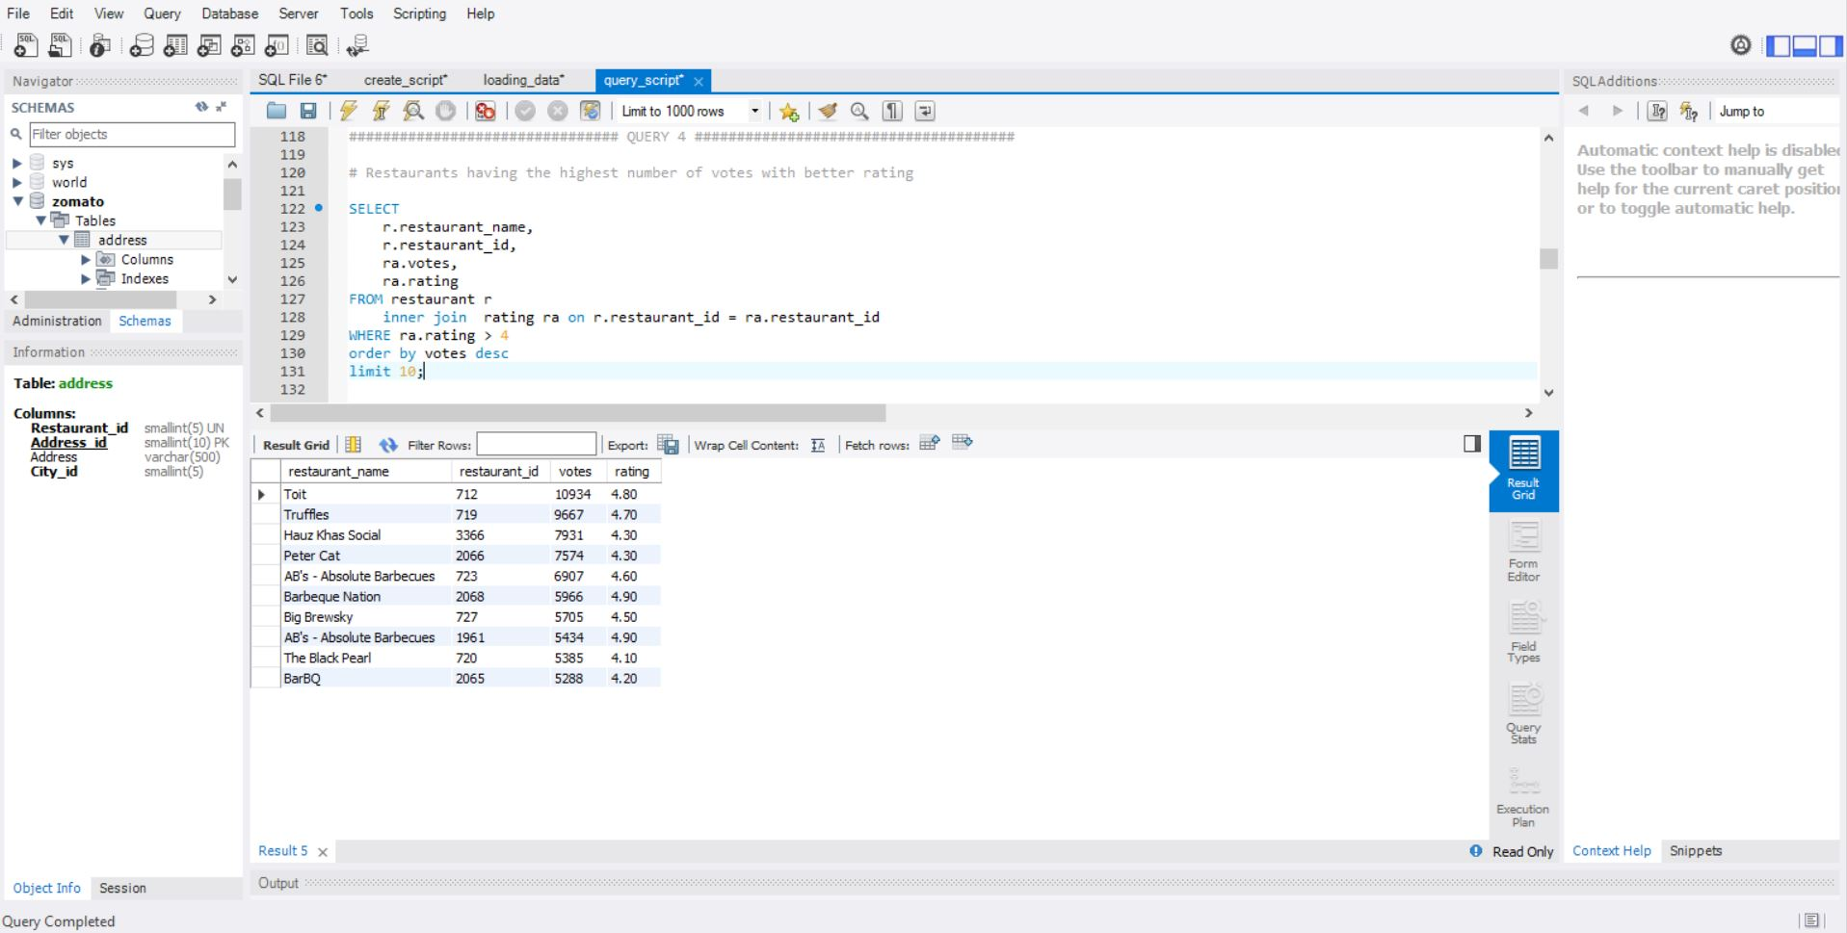

Slide 13
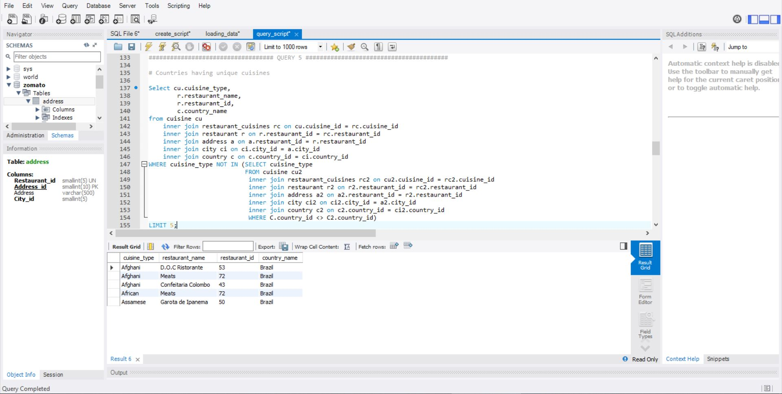

Slide 14
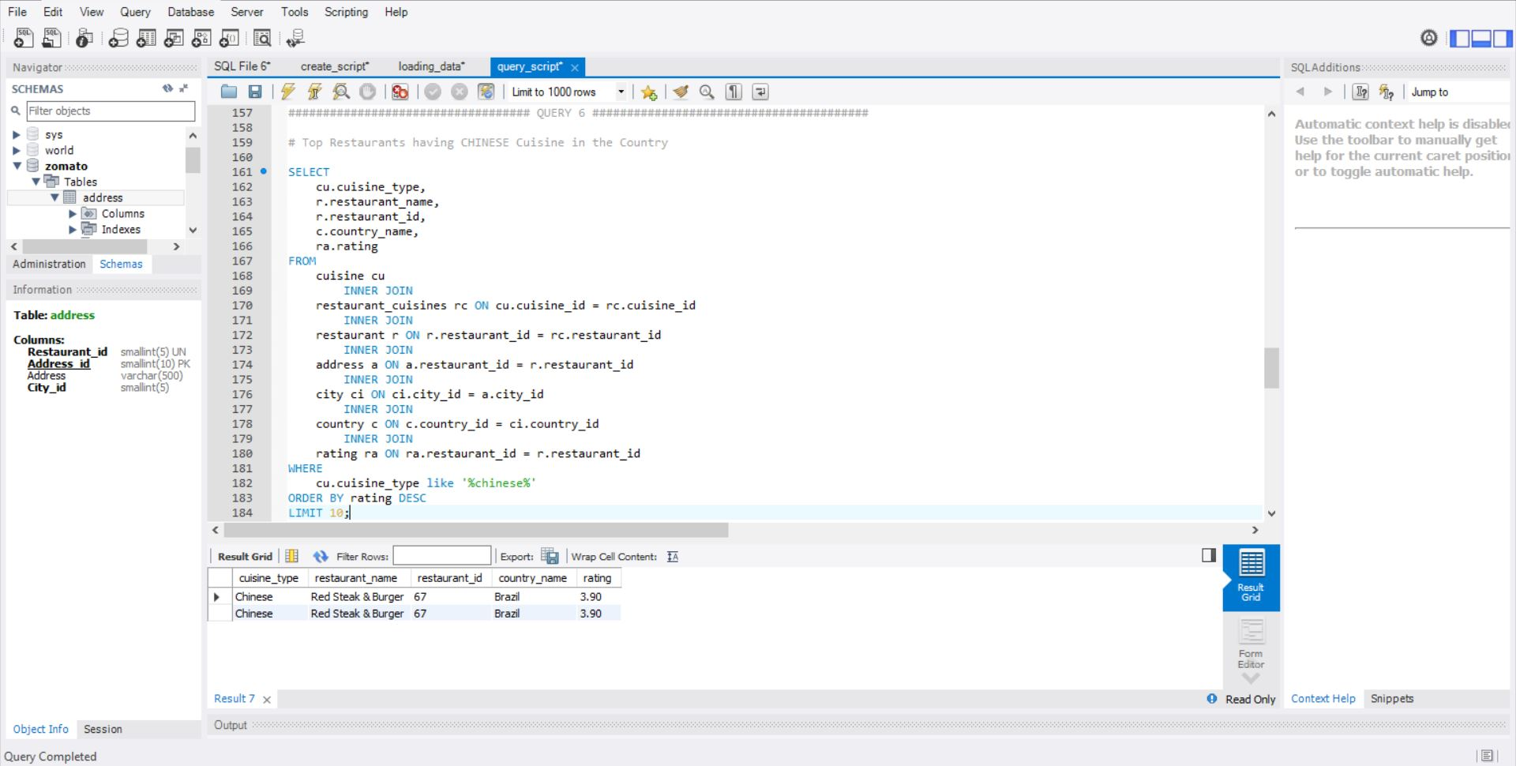
Result: 3
Result:4

Slide 15
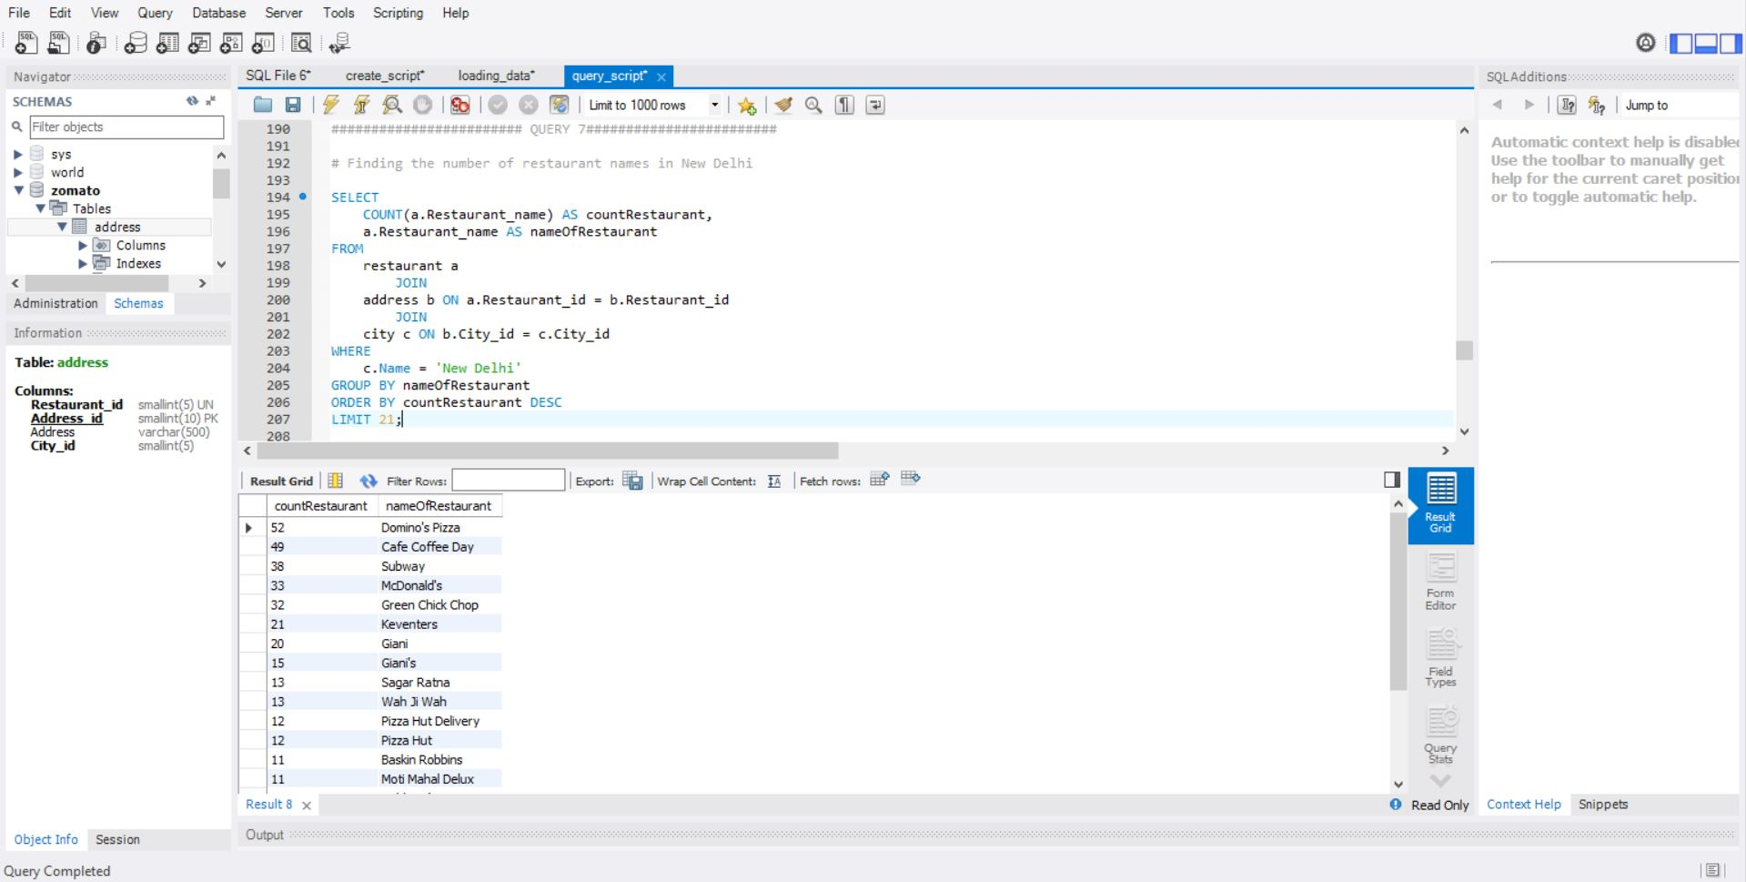

Slide 16
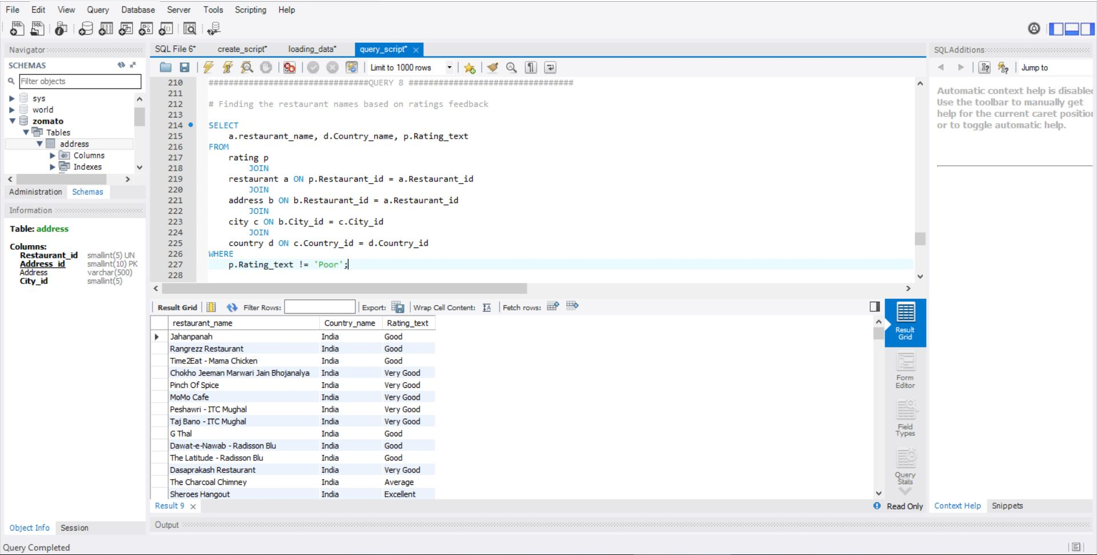

Slide 17
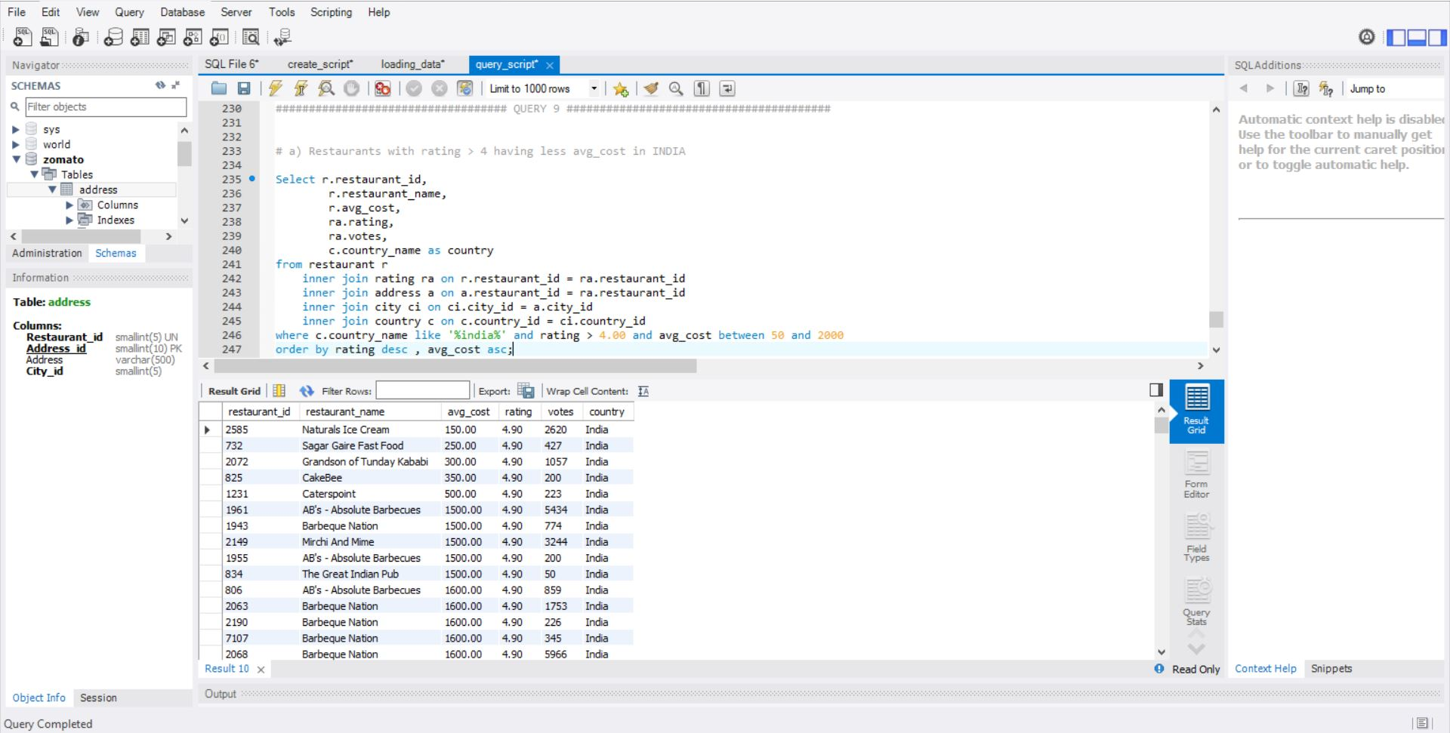

Slide 18
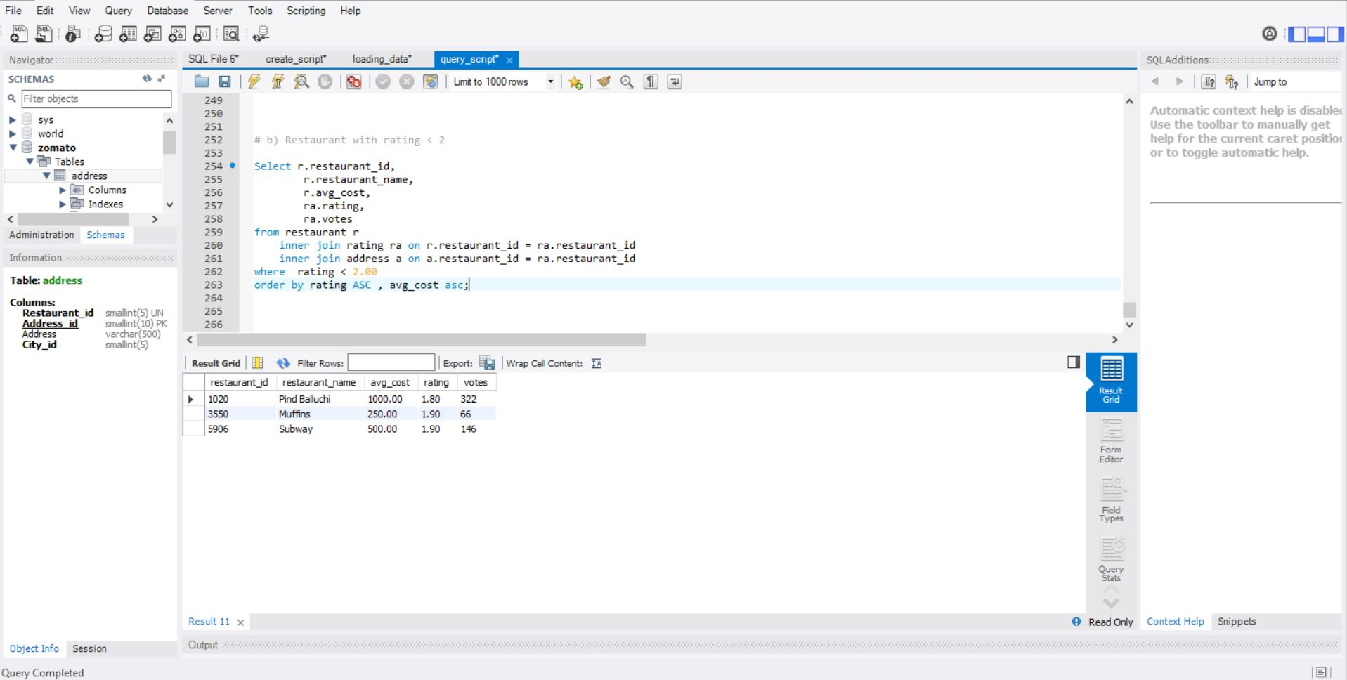

Slide 19
Visualizations Using Tableau

Slide 20
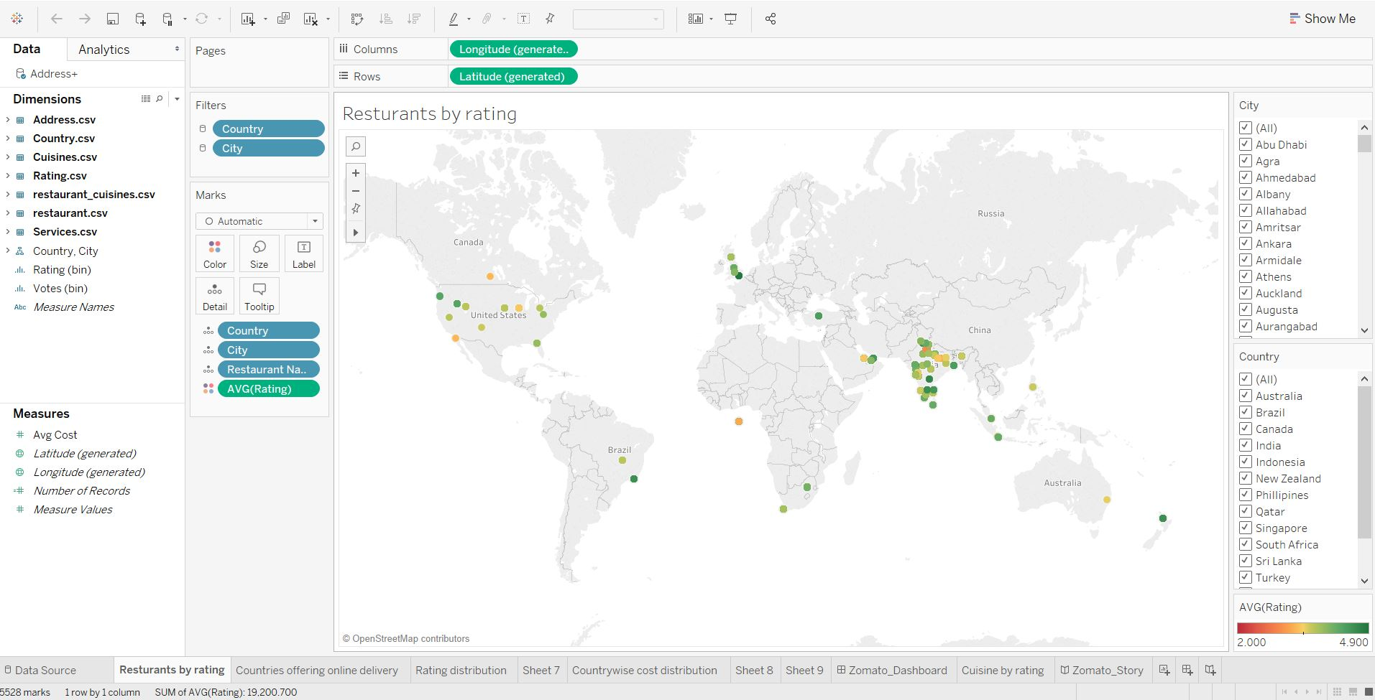
Ratings By Restaurant in countries

Slide 21
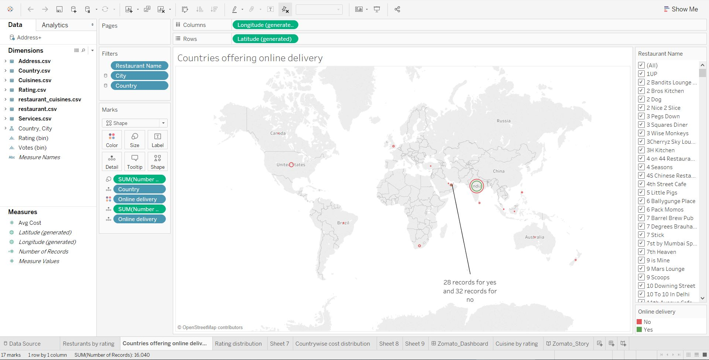
Countries Offering Online Delivery

Slide 22
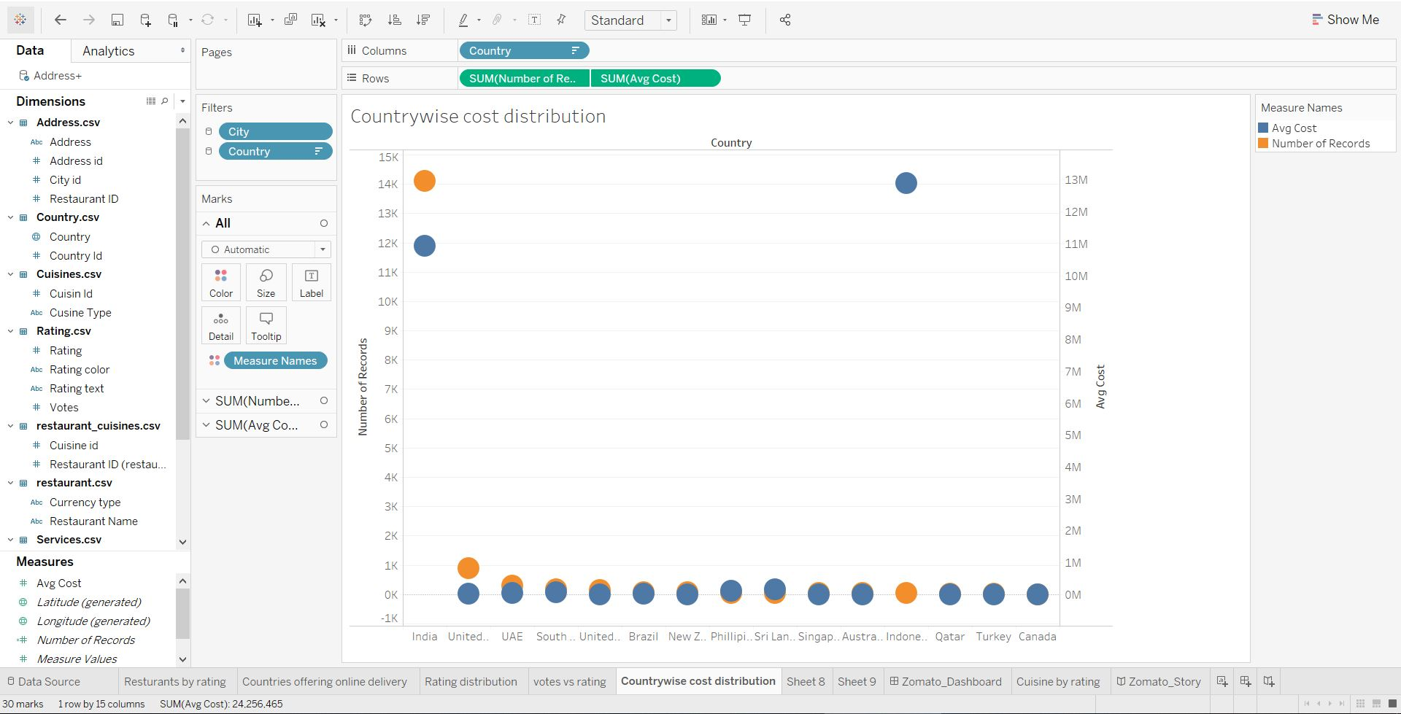
Country Wise Cost Distribution

Slide 23
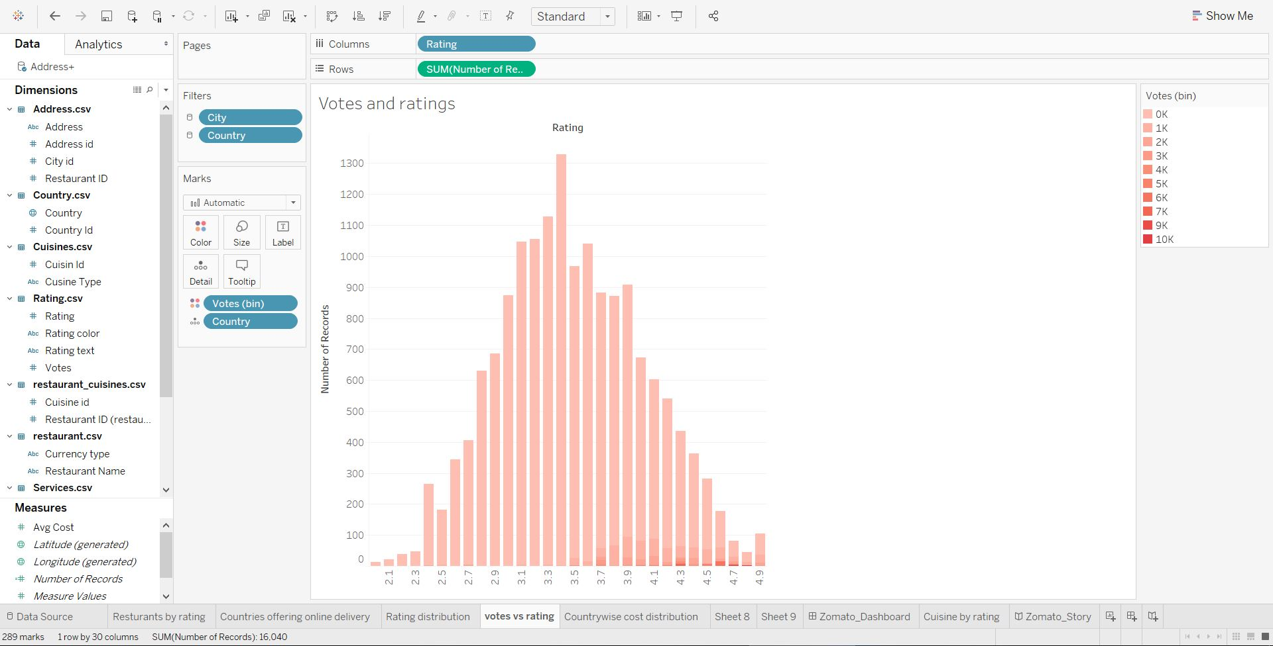
Votes vs Ratings

Slide 24
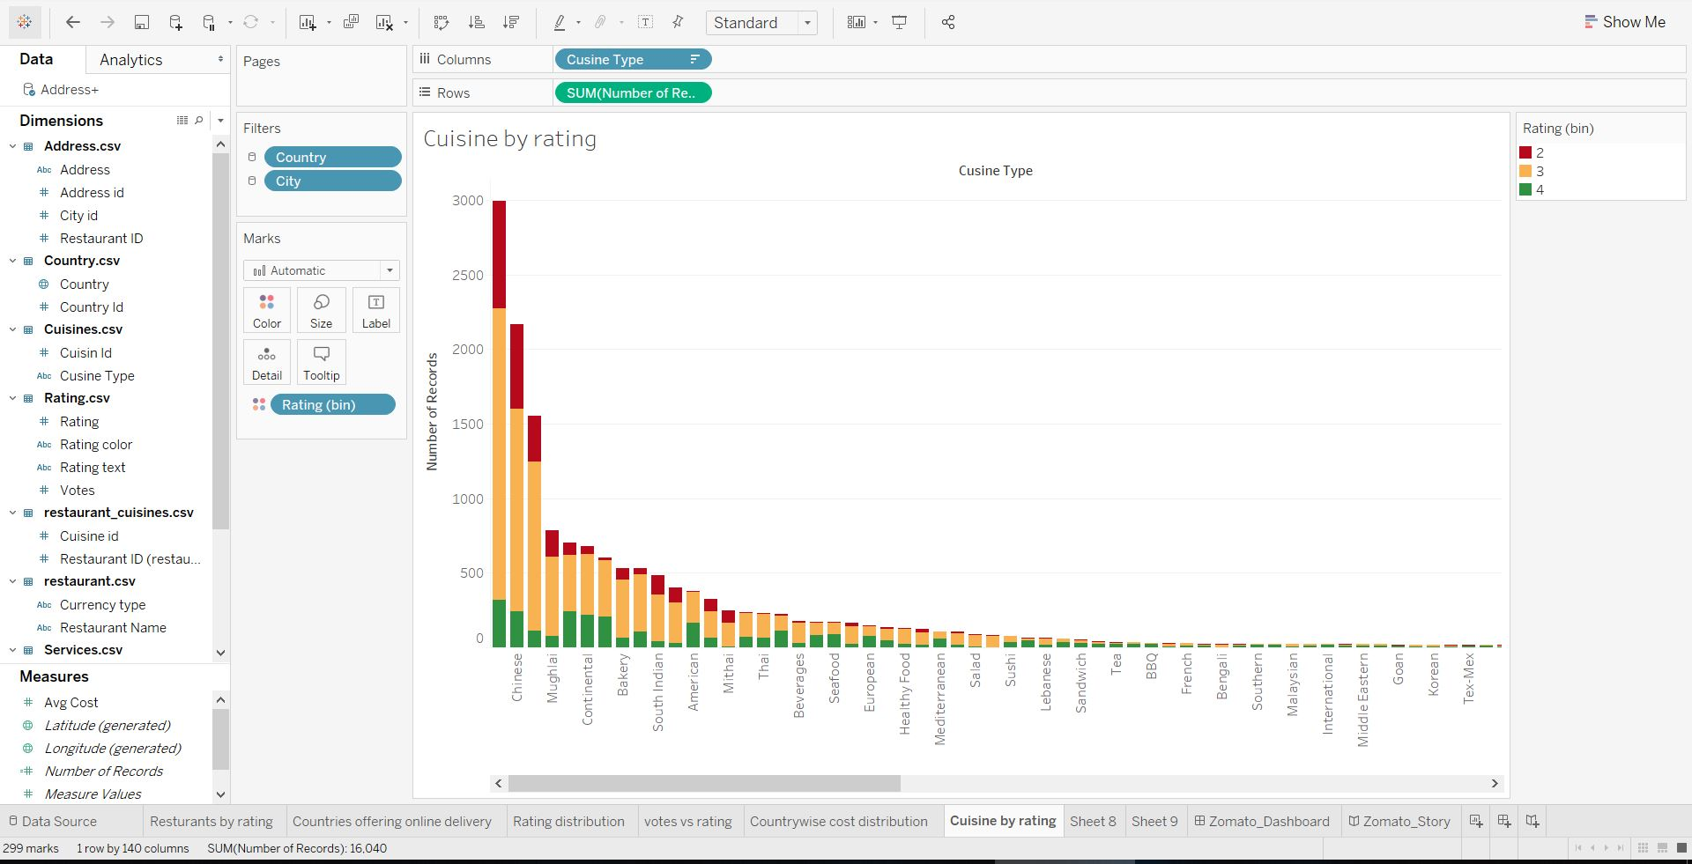
Cuisines by ratings

Slide 25
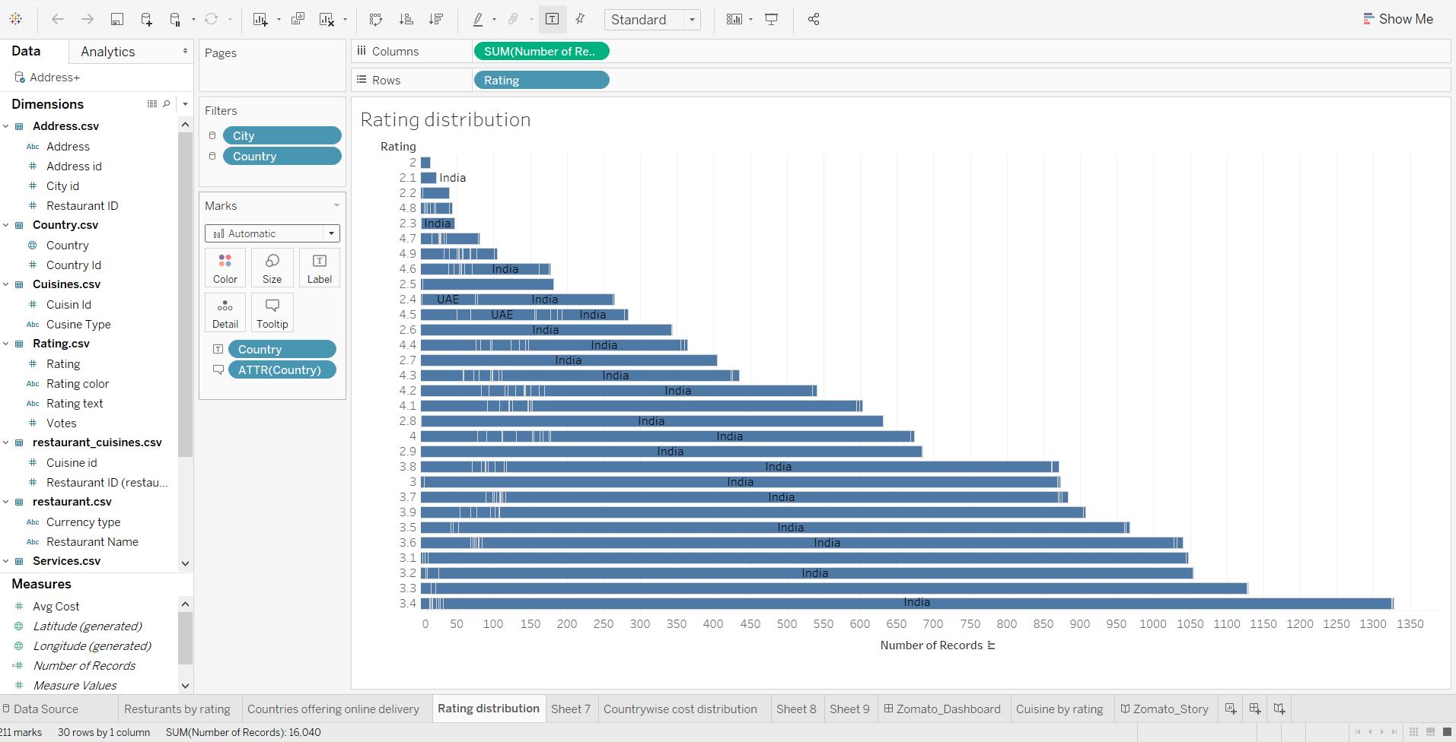
Rating Distribution

Slide 26
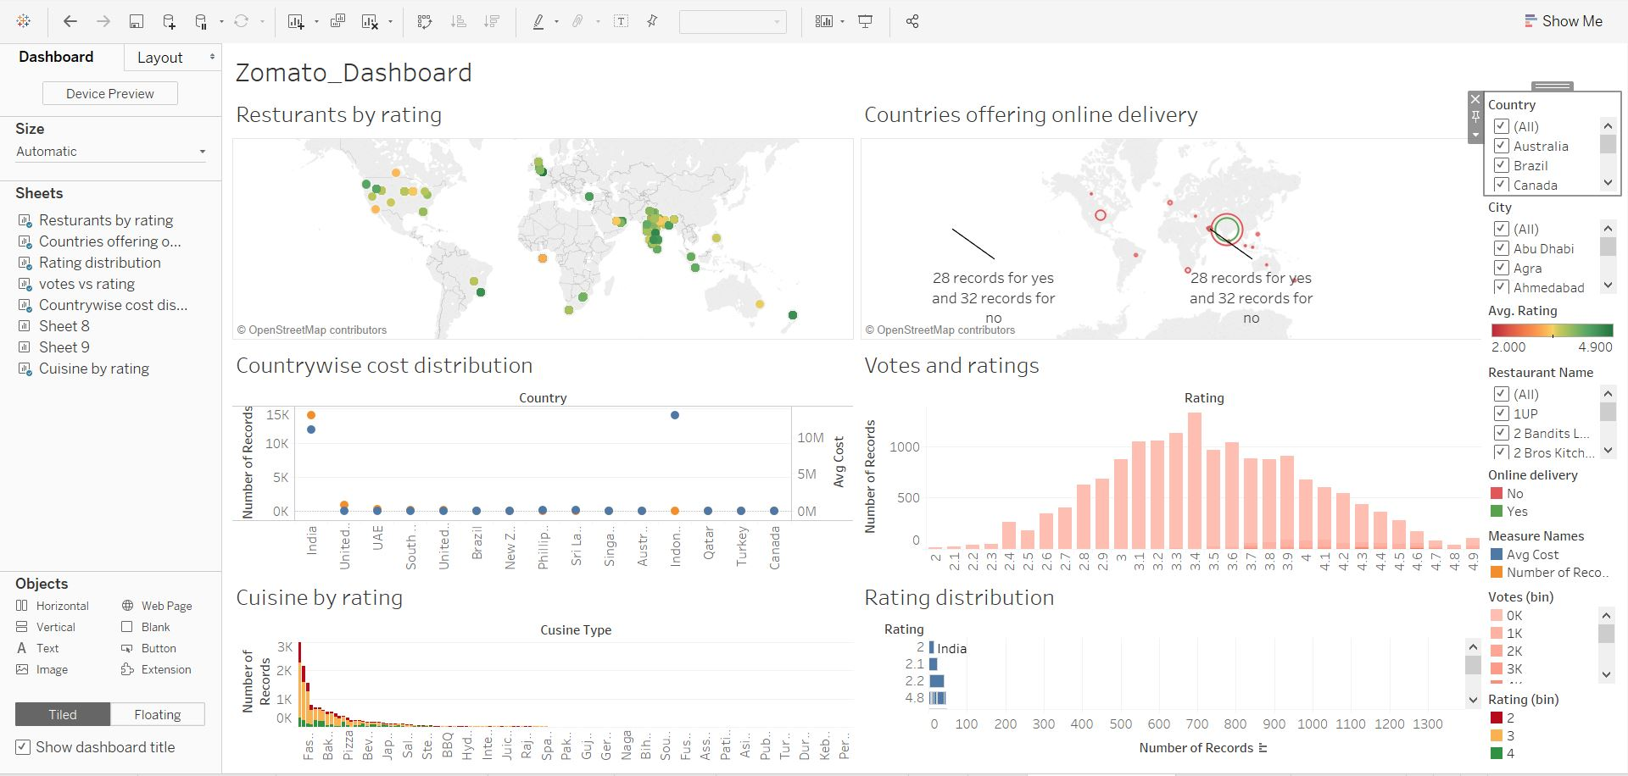
Dashboard

Slide 27
Recommendations
Based upon the number of votes and the ratings of a certain restaurant, it would be profitable for the restaurant to have online delivery.
Restaurants with lower ratings needs to add some popular cuisines in order to improve their ratings.
Restaurants which have higher average cost for two people can improve by providing them special offers and attract more customers.

Slide 28
Thank You

